Slide 1
WEEK 4 : MODEL EXPLAINABILITY
ISHAN BORKER

Slide 2
CONTENTS
ELI5
Global Interpretation Methods
ELI5 and its Usage
ELI5 Permutation Model
Partial Dependence Plots (PDPs)
Individual Conditional Expectations (ICE)
Introduction to Model Explainability
Definition
2 methods of interpretation
Local Interpretation Methods
References
Local Interpretation of Model Explanation (LIME)
SHapley Additive exPlanations (SHAP)

Slide 3
INTRODUCTION TO MODEL EXPLAINABILITY
Technique to understand any given machine learning model
When a programmer deploys any trained machine learning model, the model needs to be explained
This technique is very much essential because
When we interpret any model, the trust of machine learning model increases
After understanding the model, we find any bias present in that model
It is also important when we perform model debugging during the development
2 ways of interpretation:
Global: Understand how a model takes a decision, explain the complete behavior of the model and understand which model is suitable for deployment
Local: Understand how model will take decision for single instance, explain individual predictions and understand the behavior of model in local neighborhood

Slide 4
ELI5 and its Usage
Python library to visualize and debug different machine learning models
Inspection of model parameters done using show_weights()
Check for single prediction of model and see why a model takes a decision using show_prediction()
explain_weights and show_weights explain weights of a ML model
explain_weights → feature explanation of model weights, importance and understand working of model globally
show_weights → display model weights
explain_prediction and show_prediction explain single prediction of a ML model
explain_prediction → Explains feature importance, its impact on prediction and visualization
show_prediction → display explanation of prediction

Slide 5
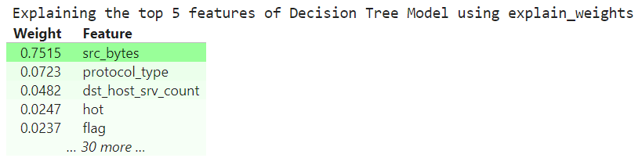
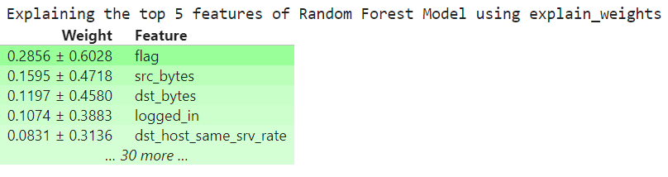
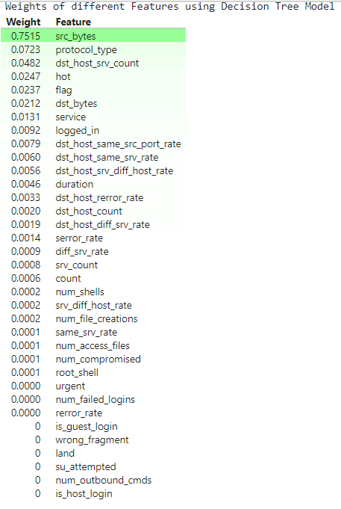
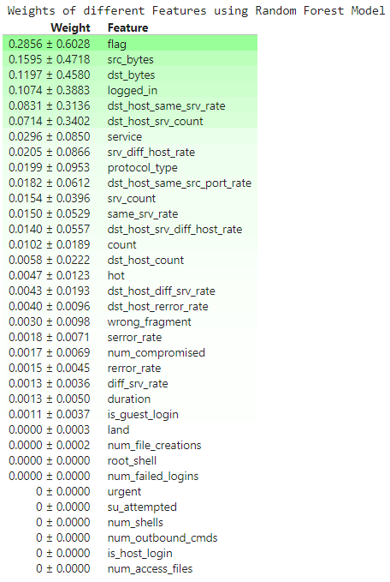
Results for explain weights and show weights

Slide 6
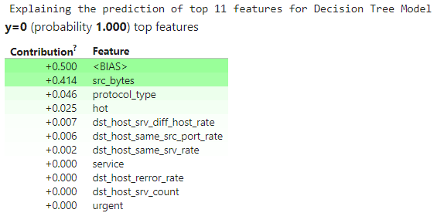
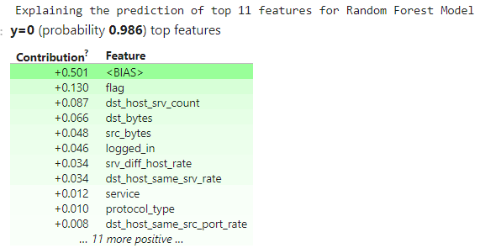
Results for Explain Prediction

Slide 7
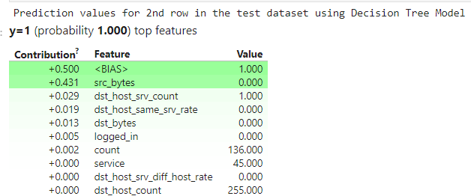
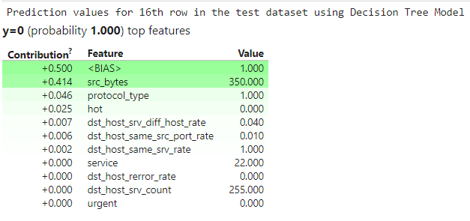
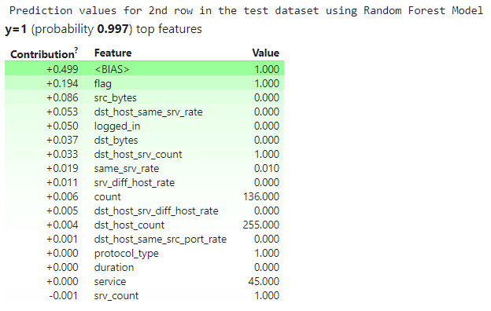
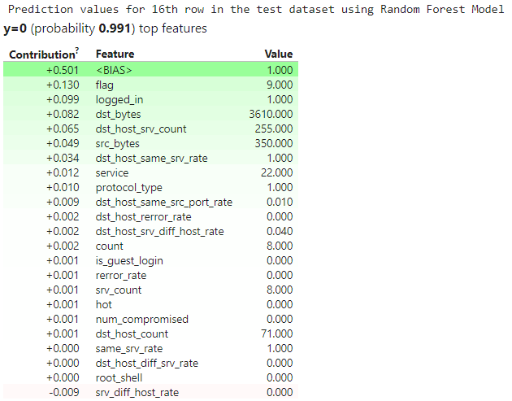
Results for Explain Prediction

Slide 8
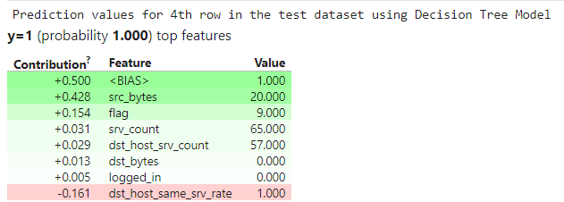
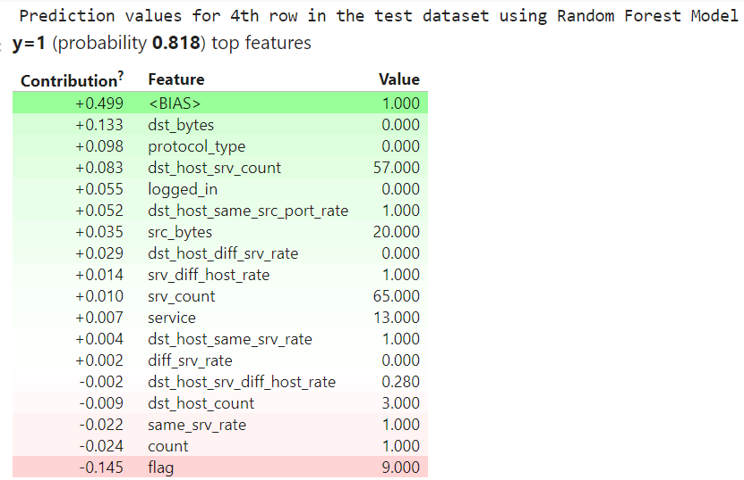
Results for Show Prediction
Insights: It helped us to find the weights of each input feature along with its contribution and feature values
Conclusion: It is the initial step of model explainability which gives us the detailed insights of all the prediction done while training the ML models

Slide 9
ELI5 Permutation Model
Show_weights is not useful for complex models
Permutation Importance is model agnostic (works on any model)
Shuffle the values of feature randomly and check how accuracy is affected and which feature is important
Repeating the shuffling on all the features gives the overall importance of each feature for comparison
Works only for global interpretation
For each feature: shuffle the values randomly, generate the predictions, compute the decrease in accuracy
Uses:
Measures the importance of each feature and check the impact of accuracy on model’s prediction
Easy to understand and interpret
Shuffles many times and gives an output as average importance and standard deviation
e.g., In the test dataset, if we randomly shuffle the values of logged_in and model's accuracy decreases, then we come to know that the logged_in is an important feature of the model.

Slide 10
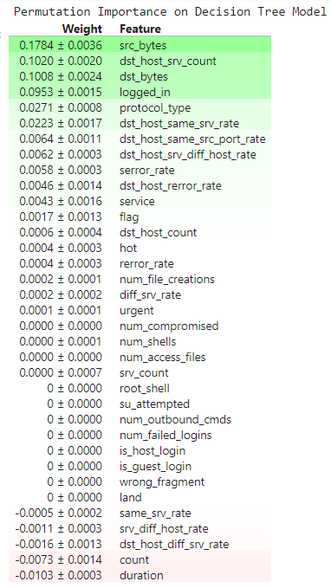
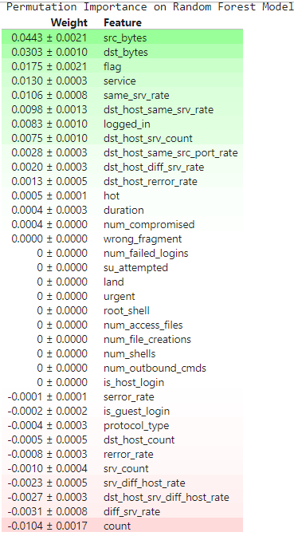
Results obtained for ELI5 Permutation Importance
Insights: It gives us the information of the weights of each input feature along with its contribution and feature values in a nutshell
Conclusion: This step will be help considering the global interpretation and identify most important features quickly after multiple random shuffling

Slide 11
Partial Dependence Plots (PDP)
Shows dependence between target and number of input features
Can be interpreted as the expected target response as a function of the input features of interest
Has smaller size of the input features
Choosing input features of interest becomes easy
Provides a global view of how the feature will affect the predictions of a model
Pros: Easy to understand, identify important features
Cons: Time-consuming, sensitive to the choice of hyperparameters
Use PartialDependenceDisplay.from_estimator () method to generate plots for each feature

Slide 12
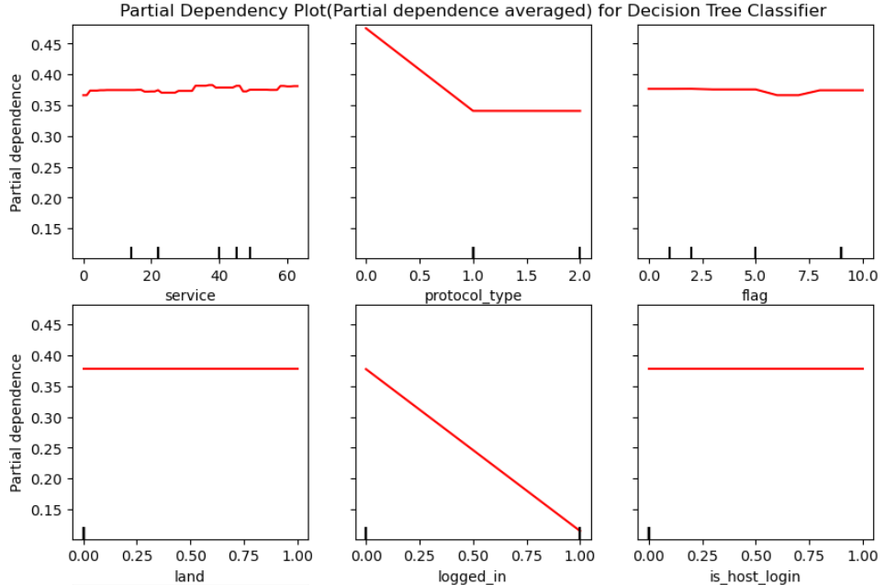
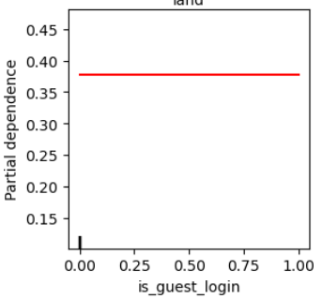
Results for Decision Tree Classifier

Slide 13
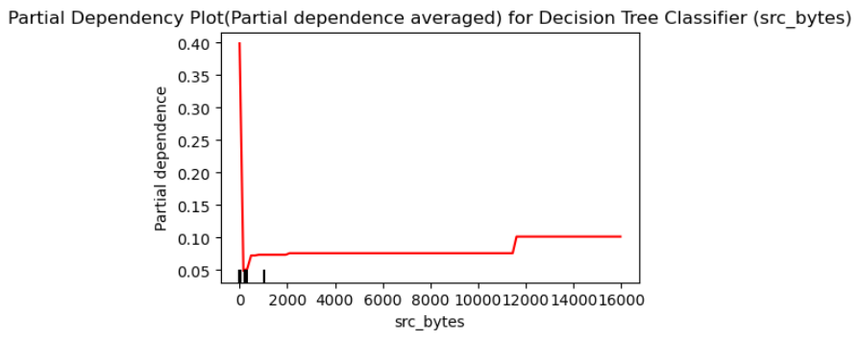
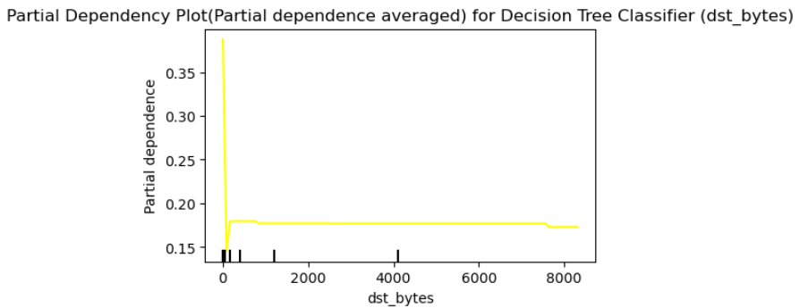
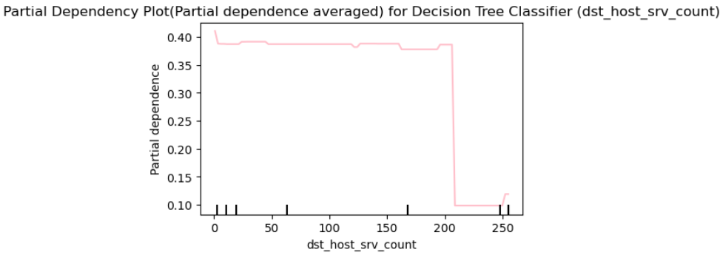

Slide 14
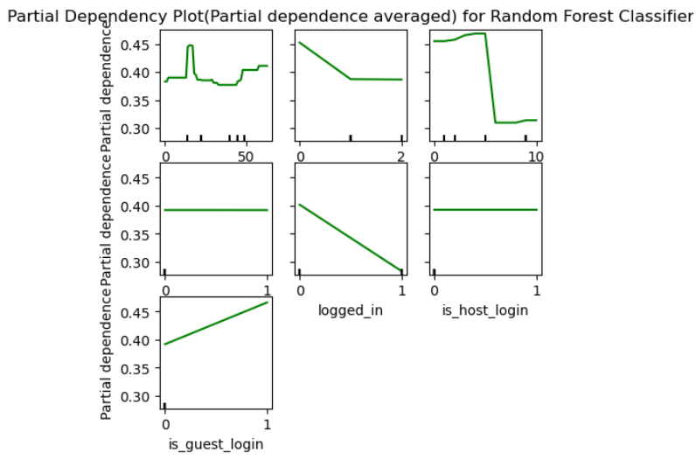
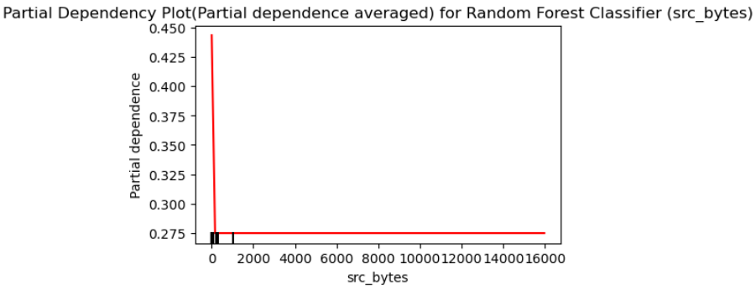
Results for Random Forest Classifier

Slide 15
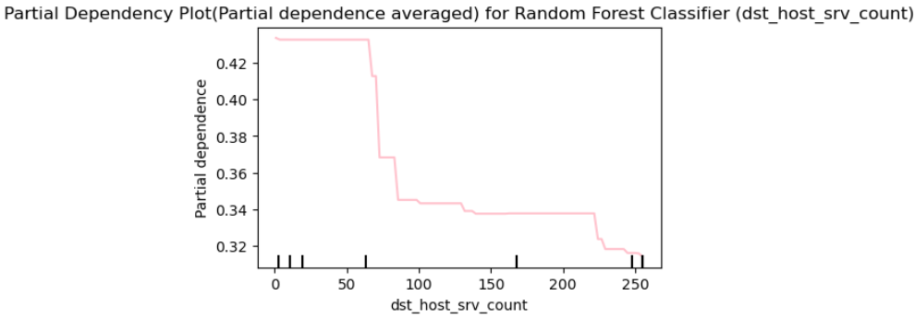
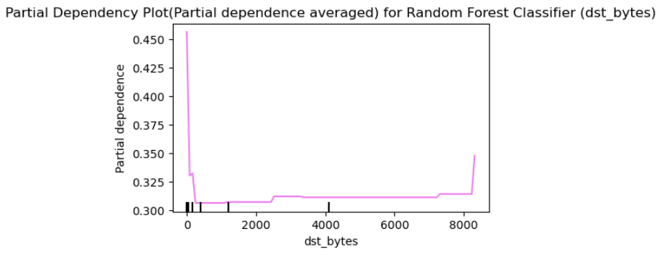
Insights: PDP for categorical variables show that there is marginal effect of input feature on the target variable and keeps rest other features constant. So, it will show the average value of target for each category. For the non-categorical features which has highest values, PDP will show the average target value for different values
Conclusion: It helps us to show the average values of all the variables and identifies if any non-linear relationships is present between input and the target variable

Slide 16
Individual Conditional Expectations (ICE)
Extension of PDP
Explains heterogeneous relationships
Can explain only 1 feature at a time compared to PDP which supports two feature explanations
Shows effect of a single instance compared to PDP which shows average effect of a feature
Requires global interpretation as it provides detailed explanation of how model makes a prediction
Use PartialDependenceDisplay.from_estimator() method with kind=’individual’ or kind=’both’ to generate ICE plots
It is used because
Identifies direction, magnitude of the impact of a feature on predicted outcome
Identifies bias in the model

Slide 17
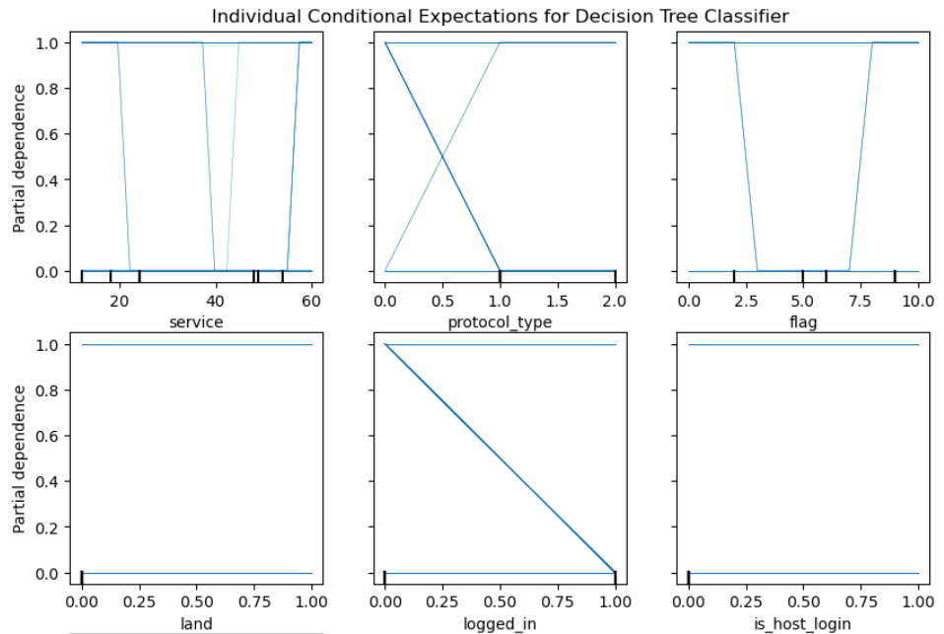
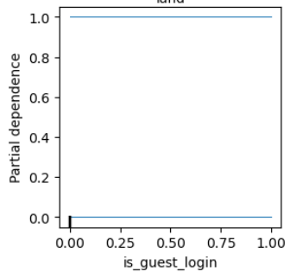
Results of ICE for Decision Tree Classifier

Slide 18
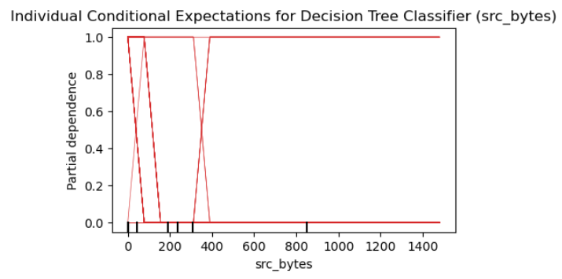
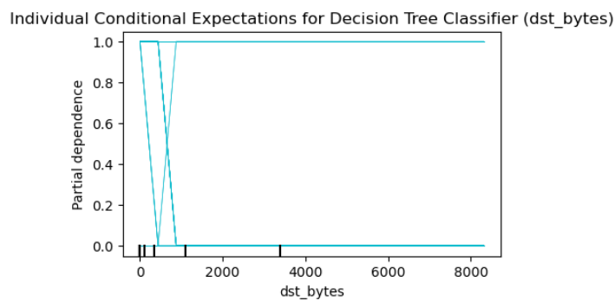
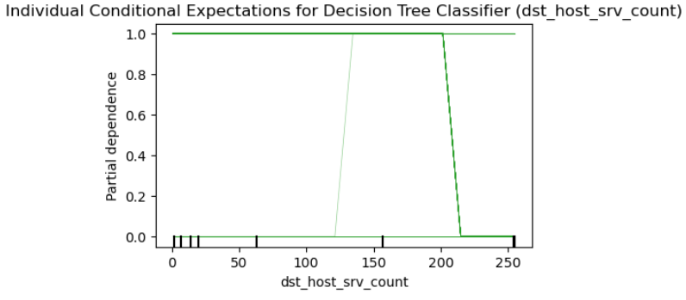

Slide 19
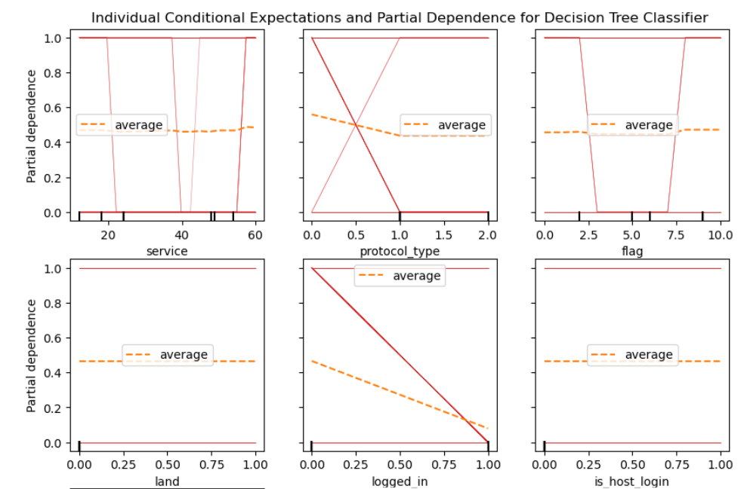
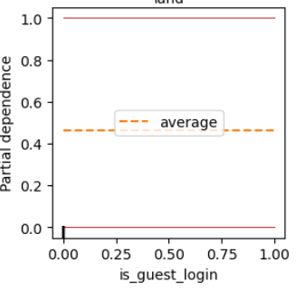
Individual Conditional Expectations and Partial Dependence for Decision Tree Classifier

Slide 20
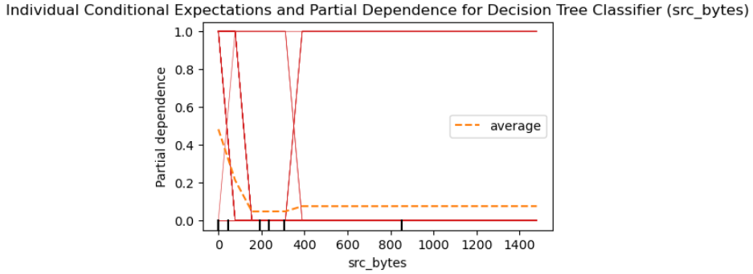
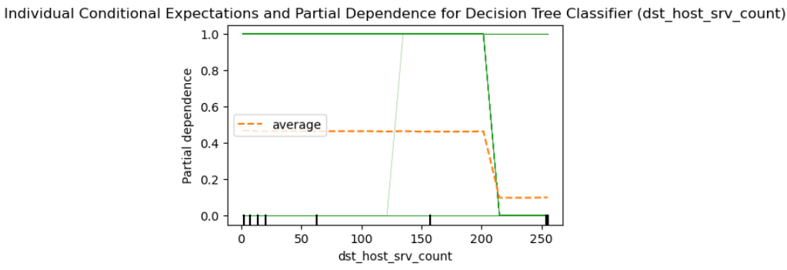
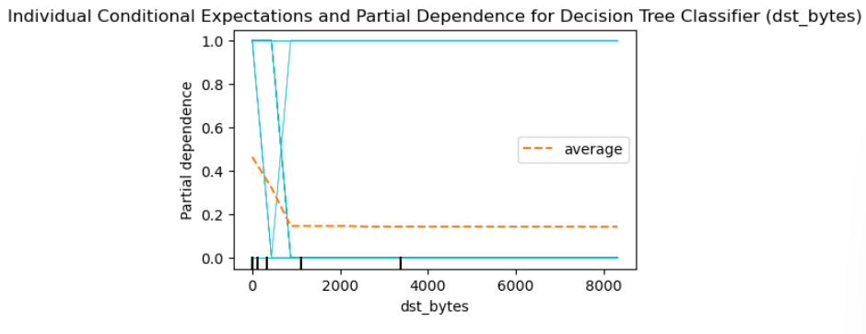

Slide 21
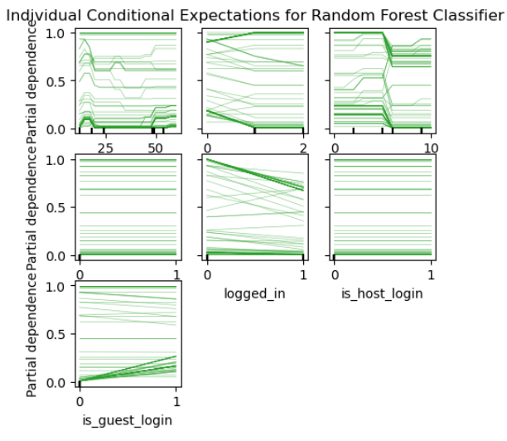
Results of ICE for Random Forest Classifier

Slide 22
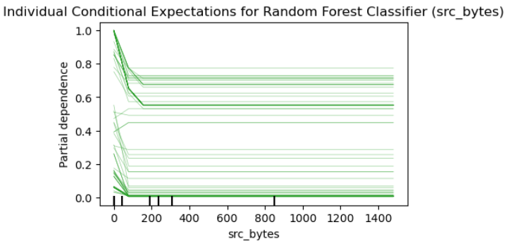
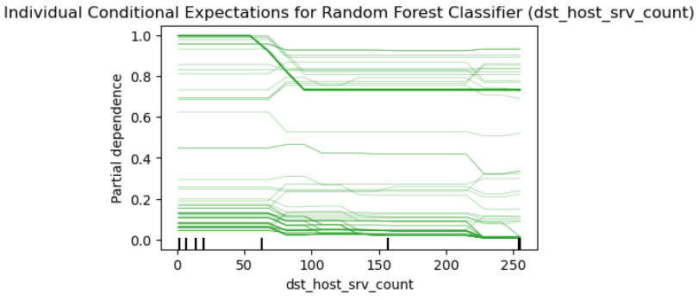
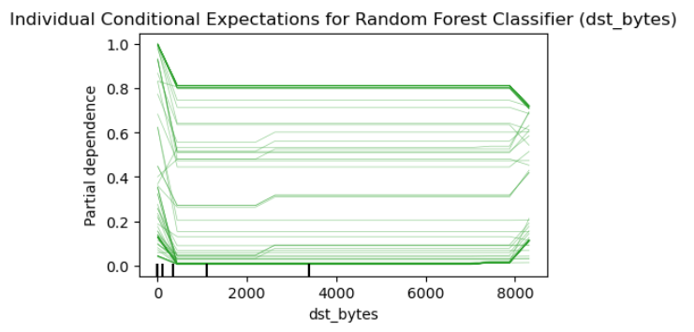

Slide 23
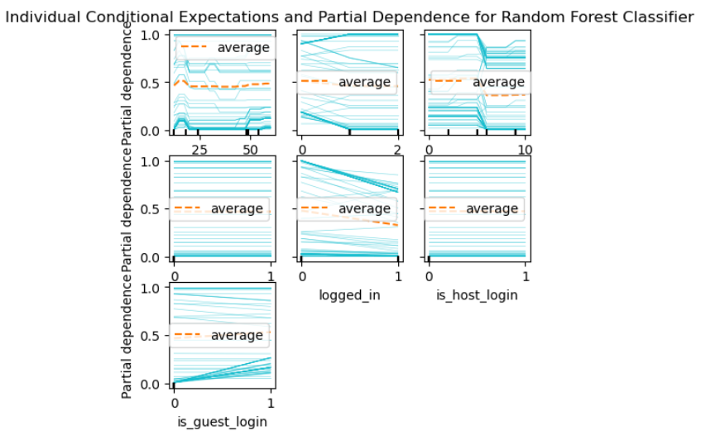
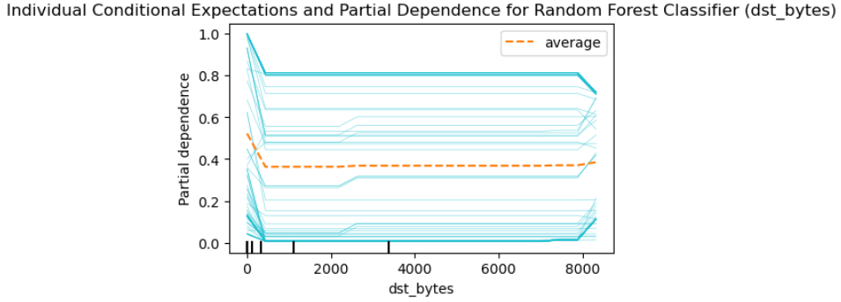
Individual Conditional Expectations and Partial Dependence for Random Forest Classifier

Slide 24
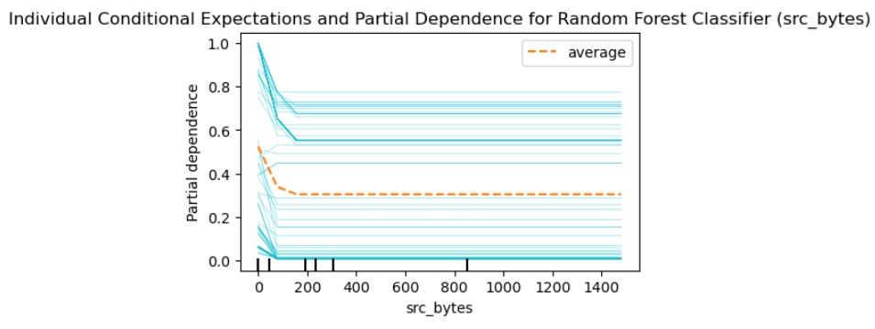
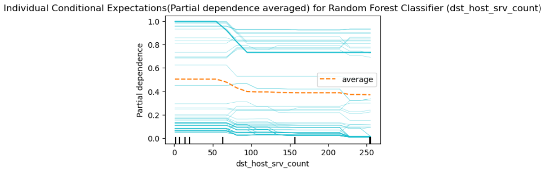
Insights: Number of features with partial dependence values are more in Random Forest Classifier than Decision Tree Classifier since more features have impact in Random Forest Classifier
Conclusion: ICE plots will display each feature which contribute to the impact of model's prediction at each data points as compared to PDP wherein it considers all data points together

Slide 25
Local Interpretation of Model Explanation (LIME)
Treats the model as a black-box and doesn’t differentiate between different classification models
Uses linear models to provide a local explanation
Provides local interpretation by modifying the feature values and observing the impact
Can be used a surrogate model and is agnostic
Aims to identify an interpretable model over the interpretable representation that is locally faithful to the classifier.
Properties:
Interpretable
Local Fidelity
Model Agnostic
Global Perspective

Slide 26
Steps in LIME
Create a permutation of data
Calculate the distance between predictions and original observations
Pick m features which describe the model and fit the simple model to the permuted data with similarity scores as weights
Weights provide explanations for the model’s best behavior
Pros:
Works well on images, text and tabular data
Faster to compute than SHAP
Cons:
Explanations dependent on the choice of hyperparameters
Similar datapoints may have different explanations

Slide 27
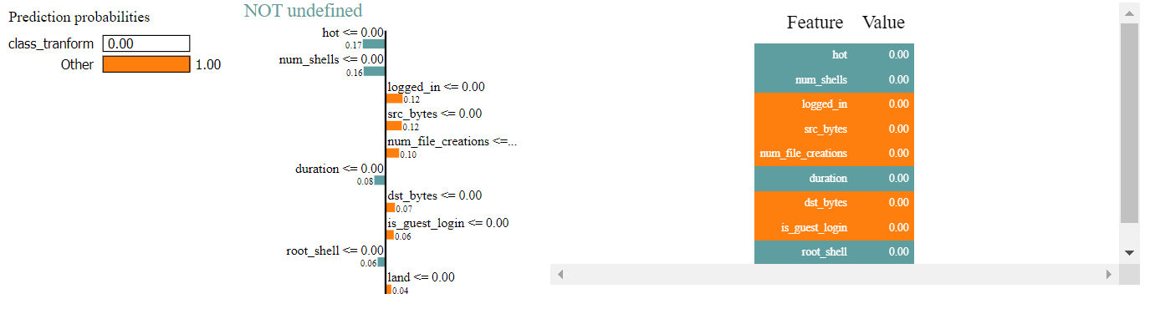
Results using Decision Tree Classifier

Slide 28
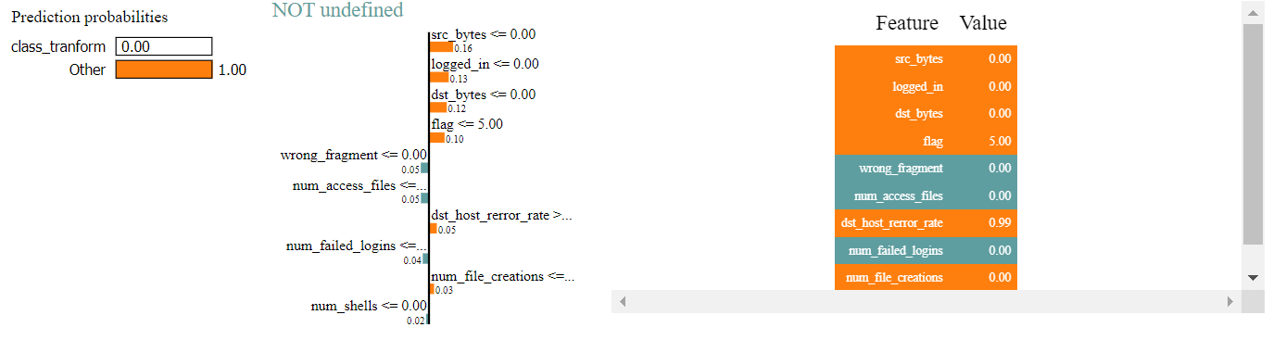
Results using Random Forest Classifier
Insights: It helps us to calculate local prediction values, right predictions and distinguishes the feature and its values based on the target variable. i.e. class (0 : Normal Connection and 1: Bad Connection) after looking at the color code
Conclusion: In the decision tree classifier, more features belonged to class 1 and less features belonged to class 0. In random forest classifier, only one feature wrong_fragment belonged to class 0 and the rest other features belonged to class 1

Slide 29
SHapley Additive exPlanations (SHAP)
Framework to explain the output of any model using Shapley values
Game theory approach
Pros:
Efficient computation on the specific model classes
Can be used globally and locally
Cons:
Requires lot of computing time
Shapley values can be misinterpreted
Only returns simple value per feature but not the prediction model like LIME
Note: Considers predict_proba function which return the probabilities of classified labels
Analyzes row of an independent data and returns the probability of the result

Slide 30
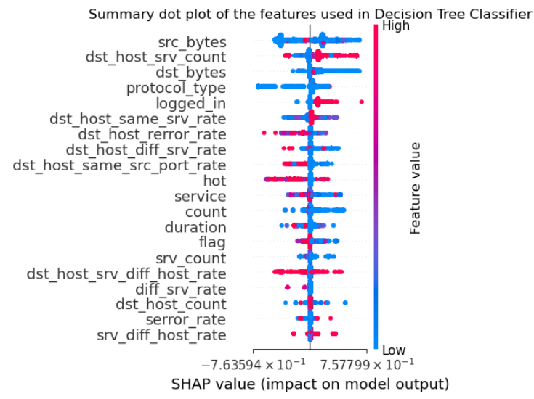
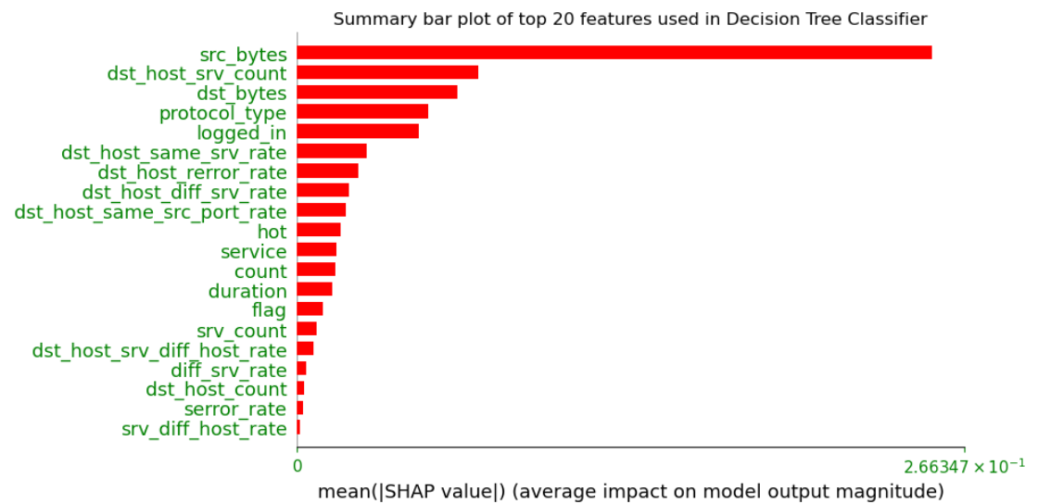
Results for Decision Tree Classifier

Slide 31
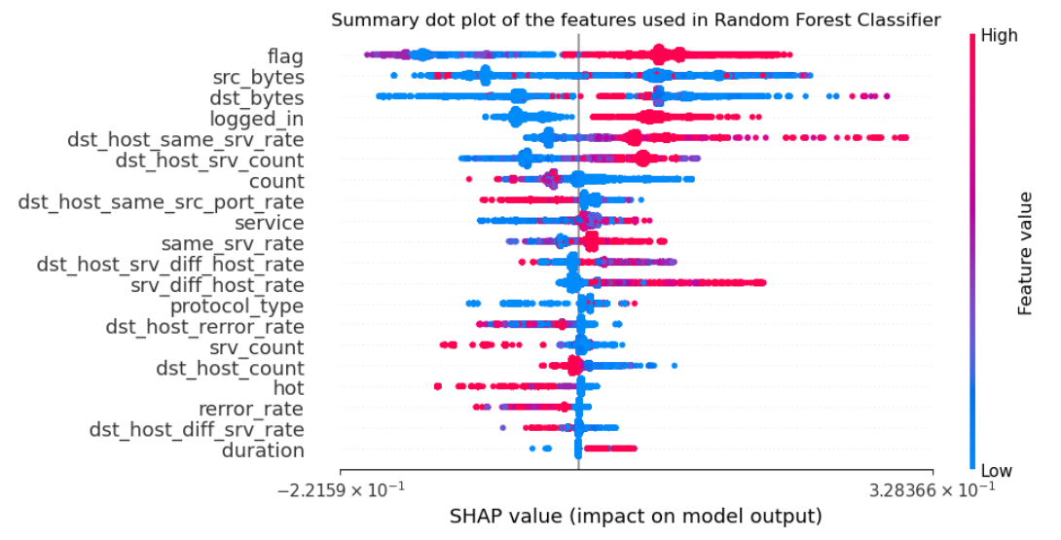
Results for Random Forest Classifier

Slide 32
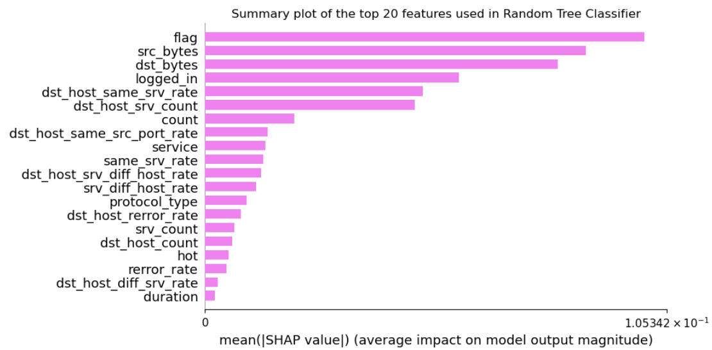
Insights: SHAP directly help to understand which feature will have maximum and minimum contribution to model's prediction
Conclusion: In Random forest classifier 6 features contribute more importantly to the model's prediction based on the mean SHAP value as compared to Decision Tree Classifier which has only 1 feature showing the highest mean SHAP value

Slide 33
References
https://www.analyticsvidhya.com/blog/2021/11/model-explainability/#:~:text=Model%20explainability%20refers%20to%20the,a%20particular%20disease%20or%20not.
https://www.analyticsvidhya.com/blog/2020/11/demystifying-model-interpretation-using-eli5/
https://www.analyticsvidhya.com/blog/2022/01/build-a-trustworthy-model-with-explainable-ai/
https://coderzcolumn.com/tutorials/machine-learning/shap-explain-machine-learning-model-predictions-using-game-theoretic-approach
https://towardsdatascience.com/a-look-into-global-cohort-and-local-model-explainability-973bd449969f
https://shap.readthedocs.io/en/latest/generated/shap.plots.force.html
https://www.twosigma.com/articles/interpretability-methods-in-machine-learning-a-brief-survey/
https://medium.com/mlearning-ai/explainable-ai-a-complete-summary-of-the-main-methods-a28f9ab132f7
https://www.analyticsvidhya.com/blog/2022/07/everything-you-need-to-know-about-lime/
https://christophm.github.io/interpretable-ml-book/pdp.html
https://coderzcolumn.com/tutorials/machine-learning/how-to-use-eli5-to-understand-sklearn-models-their-performance-and-their-predictions
https://github.com/mayur29/Machine-Learning-Model-Interpretation/blob/master/ELI5%20Model%20Interpretation.ipynb
https://towardsdatascience.com/decrypting-your-machine-learning-model-using-lime-5adc035109b5

Slide 34



